Slide 1
Radon Mitigation
Group 10

Slide 2
Introduction to Radon
Radon is a naturally occurring, radioactive, colorless, and odorless gas, formed from the breakdown of uranium in rocks and soil
Radioactive particles get trapped in lungs when inhaled which builds up over years
Long term exposure permanently damages lung tissue
Second leading cause of lung cancer in the U.S

Slide 3
Problem
Can’t be detected without proper testing
Radon is overlooked due to “low-level” exposure perception
Current radon data is available only at county level even though these levels vary street-to-street
Lack of awareness thus neglected

Slide 4
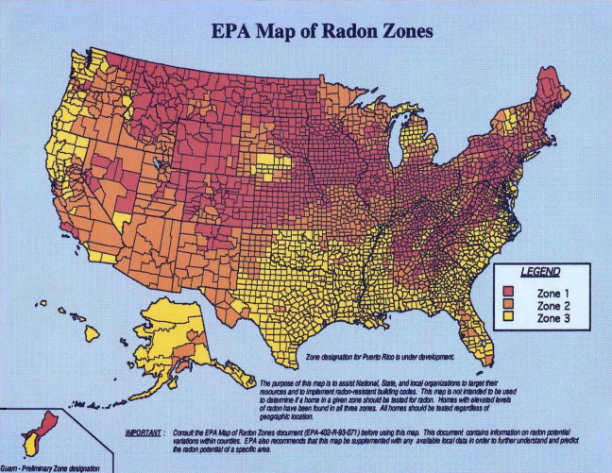
Why current systems are inefficient
Radon public data only shows average county-level radon
Ground composition differs even within small areas
Lack of real-time localized radon measurement systems

Slide 5
Solution: Radon Mitigation
A centralized Radon detection, analysis, and response system
Aggregates real inspection data across the U.S.
Combines geological composition data with radon readings
Provides property-level radon exposure insights
Offers lifetime radiation exposure estimation & risks

Slide 6
How Radon Mitigation works
Home inspectors upload radon test results during inspections
Construction workers report job-site radon levels
Government geological databases integrated for soil composition and fractured soil understanding to identify high Radon producing materials(granite, shale, phosphate, etc)
AI algorithm estimates exposure risk by location using the available data
Generates a dynamic national radon heat map at a street/property level

Slide 7
Who this helps
Homeowners and buyers
Real estate agents
Construction workers
City planners
Government
Radon mitigation service providers

Slide 8
Long-term impact
Improves public health awareness
Encourages early mitigation investment into anti-Radon practices
Supports regulatory laws & compliances
Creates new transparency in environmental risk
Protects individuals & workers exposed to high risk ground types

Slide 9
Conclusion
Our intention is to have Radon Mitigation transform radon detection from a static county average into a dynamic, property-specific, data-driven underground environmental intelligence system.

